Slide 1
GALC Lot Control Client prototype

Slide 2
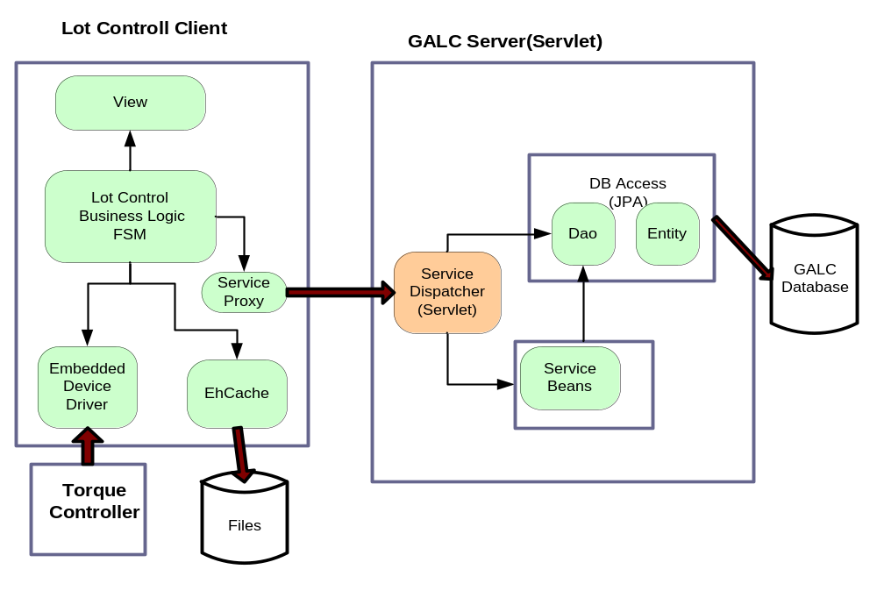
Rich Client Approach
I

Slide 3
Simple Lightweight Server
Communication channel - Servlet
Database access - JPA
Service definition – Dao interface , typed parameters
Fast start up time ( A few seconds)
Scalable by setting up Web server clustering

Slide 4
Lot Control Client
Load client related data on start up
Direct client Dao access eliminates server Dao façade codes and simplifies client side programming
Get object graph from one Dao service call
Embedded Torque Device Driver
Finite State Machine (FSM) maintains client state
Ehcache persistent cache enables online and offline mode

Slide 5
Ehcache – Persistent Cache
Widely used proven open source java cache
Conforms JSR107 JCache standard
Small memory footprint – one jar, 262kb
Embedded in java client applications
Cache file small size

Slide 6
What we cached
ApplicationContext – terminal, application by terminal, applications etc
ClientContext – terminal specific lot control rules, production lots, engine mtos
DeviceData – process point specific device, device data formats
PropertyService – client specific properties
InstalledParts – installed parts and torque measurement data when it is offline

Slide 7
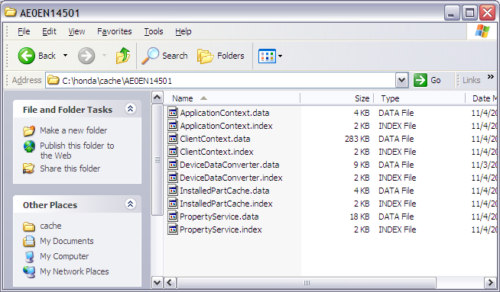
Cache files

Slide 8
Online mode
when server is available
Load ApplicationContext, ClientContext, DeviceData, Properties from cache on startup
Refresh above data from server on startup when server is available
Verify product and parts from the server, verify part masks and process torques based on lot control rules and save torque results to server

Slide 9
Offline Mode
When server is not available
Load ApplicationContext, ClientContext, DeviceData, Properties from cache on startup
Verify part masks and process torques based on local lot control rules, does not verify product status, part duplication etc, save torque results into local cache
When system back on line restore torque results to server

Slide 10
Client Dao Service
PlantDao plantDao = DaoFactory.getDao(PlantDao.class);
List<Plant> plants = plantDao.findAll();
for(Plant plant: plants) {
System.out.println("Plant : " + plant.getId().getPlantName() + plant.getId().getSiteName());
for (Division division : plant.getDivisions()) {
System.out.println("Division: " + division.getDivisionId() + "name: " + division.getDivisionName());
}
}

